Slide 1
Time Value of Money
Presented by [Name]

Slide 2
Decision Dilemma—Take a Lump Sum or Annual Installments
A couple Won a Lucky Draw.
They had to choose between a single lump sum $104 million, or $198 million paid out over 25 years (or $7.92 million per year).
The winning couple opted for the lump sum.
Did they make the right choice? What basis do we make such an economic comparison?

Slide 3
Time Value of Money
An important principle in finance is that the value of money is time dependent.
The value of a unit of money is different in different time periods.
The value of a sum of money received today is more than its value received after some time.
The preference for money now, as compared to future money is known as time preference of money.

Slide 4
Time Preference for Money
The time value of money (TVM) is the idea that money available at the present time is worth more than the same amount in the future.
Risk
Inflation
Investment opportunity
Personal Consumption

Slide 5
Application of Time Value
Most financial problems involve cash flows occurring at different points of time. These cash flows have to be brought to the same point of time for purposes of comparison and aggregation.
Hence the understanding of the tools of compounding and discounting which underlie most of what we do in finance –
Valuing securities
Analysing projects,
Determining lease rentals
Choosing the right financing instruments,
Setting up the loan amortization schedules

Slide 6
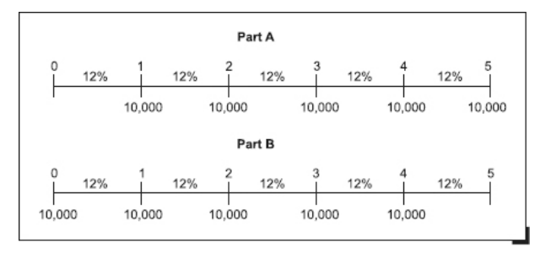
Time Lines and Notation
When cash flows occur at different points in time, it is easier to deal with them using a time line.
A time line shows the timing and the amount of each cash flow in a cash flow stream.

Slide 7
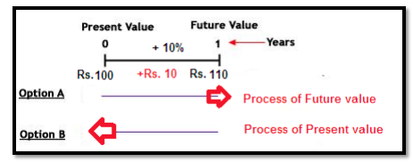
Time Value of Money
Present value (PV)
current value of a future sum of money or stream of cash flows given a specified rate of return. In the above example 200 is the present value of 220.
Future value (FV)
Value of a current asset at a specified date in the future based on an assumed rate of growth. In the above example 220 is the future value

Slide 8
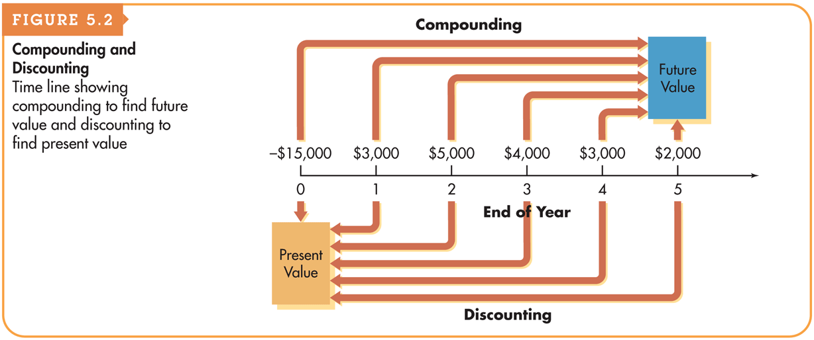
Techniques for Time Value of Money
Two methods to calculate the time value of money
Compounding Technique
Discounting Technique

Slide 9
Basic Patterns of Cash Flow
The cash inflows and outflows of a firm can be described by its general pattern. The three basic patterns include a
single amount or Lump sum
an annuity,
mixed stream or uneven cash flow

Slide 10
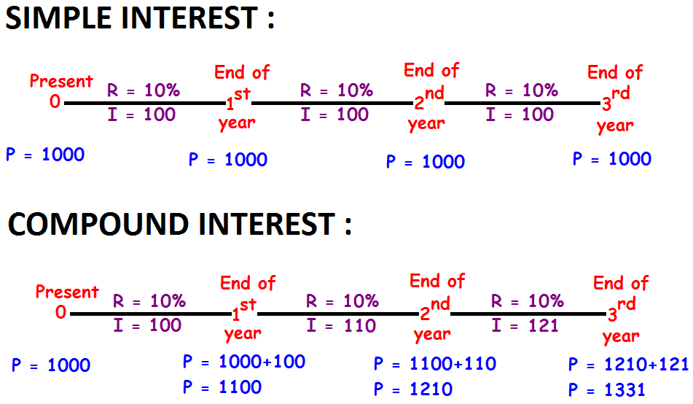
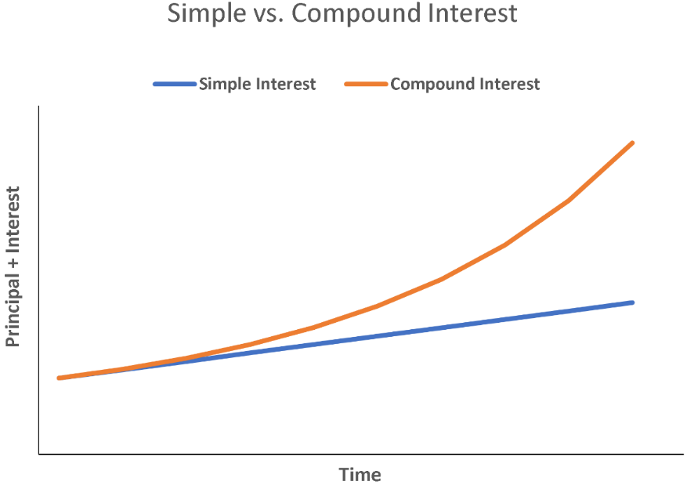
Simple Interest and Compounding Interest
Simple Interest – the interest that is calculated only on the original amount
Compounding Interest – the interest that is received on the original amount as well as on any interest earned but not withdrawn during earlier periods

Slide 11
Future Value and Compounding
Future value is the value at a given future date of an amount placed on deposit today and earning interest at a specified rate. Found by applying compound interest over a specified period of time.
FV_{n} = PV × (1 + r)^{n}
FV_{n} = future value at the end of period n
PV = initial principal, or present value
r = annual rate of interest paid.
n = number of periods (typically years) that the money is left on deposit

Slide 12
Example-1
If you invested 2,000 today in an account that pays 6% interest, with interest compounded annually, how much will be in the account at the end of two years if there are no withdrawals?
0 1 2
6%
2,000
FV

Slide 13
Example-2
John wants to know how large his 5,000 deposit will become at an annual compound interest rate of 8% at the end of 5 years.
0 1 2 3 4 5
5,000
FV₅

Slide 14
Example-3
Mr. Anil has received Rs. 30,000 as gifts from his relatives during Diwali celebrations. He wanted to save this money in the piggy bank so that he could buy an expensive cricket kit after five years. His father has suggested that he should invest the money in a bank so that the savings could grow. He went through Bank-ka-Bazaar website to find out the options available to him. Calculate the value of the investment after five years under the following options. (Assume annual compounding)
a. SBV is offering FD account at 8% interest p.a.
b. BUB is offering an FD account at 10% interest p.a.
c. HFDC bank is offering FD account at 12% interest p.a.
d. Mr. Aakash, Anil’s father has offered to pay 15% interest p.a.

Slide 15
Frequency of Compounding
FV_{n} = PV₀(1 + [r/m])^{mn}
n: Number of Years
m: Compounding Periods per Year
r: Annual Interest Rate
PV₀: PV of the Cash Flow today

Slide 16
Example -4
Suppose you deposit 1,000 in an account that pays 12% interest, compounded half yearly. How much will be in the account after four years if there are no withdrawals?

Slide 17
Future Value of Multiple Uneven Cash Flows
Mr. Binil planned to invest Rs. 60,000 at the end of first year, Rs. 90,000 per year in 2nd and 3rd year-end and Rs. 110,000 in three years thereafter. Calculate the compounded value at the end of year 6 at an interest rate of 10% p.a. (payments are made at the end of the period)

Slide 18
Annuity
A series of level/even/equal sized cash flows that occur at the end of each time period for a fixed time period
Examples of Annuity
Car Loans
Home Loans
Insurance Policies
Retirement Money

Slide 19
Annuity
An annuity is a stream of equal periodic cash flows, over a specified time period. These cash flows can be inflows of returns earned on investments or outflows of funds invested to earn future returns.
An ordinary (deferred) annuity is an annuity for which the cash flow occurs at the end of each period
An annuity due is an annuity for which the cash flow occurs at the beginning of each period.
FV of an annuity due will always be greater than an otherwise equivalent ordinary annuity because interest will compound for an additional period.

Slide 20
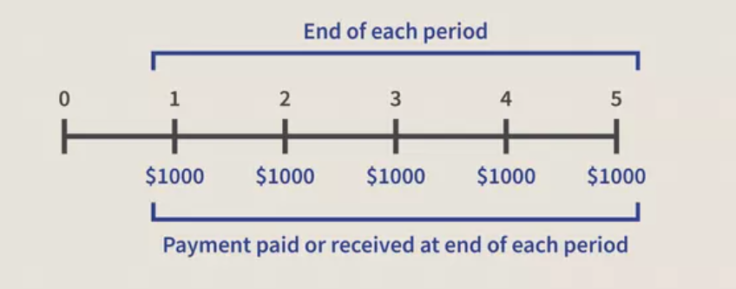
Future Value of Annuity
A constant Sum of 1000 is deposited at the end of each year for next 5 years at 5% of interest rate. What will be the value of this annuity after 5 years.

Slide 21
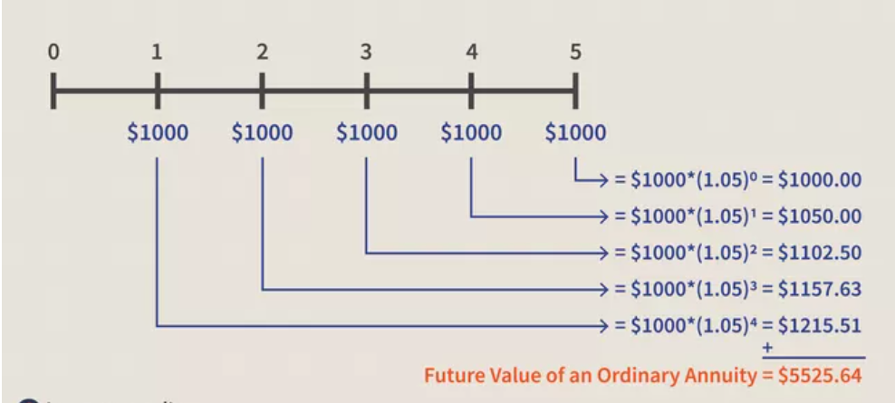
Conti…

Slide 22

Finding the Future Value of an Ordinary Annuity
You can calculate the future value of an ordinary annuity that pays an annual cash flow equal to CF by using the following equation:
As before, in this equation r represents the interest rate and n represents the number of payments in the annuity (or equivalently, the number of years over which the annuity is spread).

Slide 23
Example-5
Ms. Seema is saving to go to Las Vegas after 10 years. She believes that her plan to go to Las Vegas may cost her 3,000,000. Interest rate is 10%.
If She can save 200,000 every year-end for ten years, Is it sufficient to plan a vacation in Vegas? Calculate the short-fall/ surplus.
How much does she need to save every year for planning a trip in Las Vegas?

Slide 24

Finding the Future Value of an Annuity Due
You can calculate the present value of an annuity due that pays an annual cash flow equal to CF by using the following equation:
As before, in this equation r represents the interest rate and n represents the number of payments in the annuity (or equivalently, the number of years over which the annuity is spread).

Slide 25
Present Value and Discounting
Discounting is the process of translating a future value or a set of future cash flows into a present value.
The current value of future cash flows discounted at the appropriate discount rate over some length of time period.
PV₀ = FV_{n} / (1 + r)^{n}
^{Where:}
r= Interest rate (r), and
n = Time period (n)
FV_{n =} Future Value after n years

Slide 26
Example-6
Joann needs to know how large of a deposit to make today so that the money will grow to 2,500 in 5 years. Assume today’s deposit will grow at a compound rate of 4% annually.
0 1 2 3 4 5
2,500
PV₀

Slide 27
Example-7
Your father has promised to give you Rs. 1,000,000 in cash on your 25th birthday. Today is your 15th birthday. How much he should save today in a lump sum so that he could give you Rs. 1000,000. You can take the discount rate of 10%. What would be your answer if investment returns is 12%?

Slide 28


Present value of Ordinary Annuity
Present value of Due Annuity
X

Slide 29
Example -7
Suppose that there is an annuity payment of $1,000 for the next 5 years beginning at every end of the year. You are required to compute the present value of the annuity, assuming a rate of interest is 5%.

Slide 30
Present Value of uneven cash flows
Mr. Manoj is going to receive a pension of Rs. 500 at the end of year 1, Rs. 1000 at the end of year 2 and Rs. 2000 at the end of the years 3,4 and 5. Calculate the present value if the discount rate is 10%.

Slide 31
Example
Mr. Ravi wants to save for the college education of his son, Deepak. Mr. Ravi could save Rs. 40,000 every year-end for five years so that he could pay the fees in lump sum after five years. (College fees is expected to be Rs. 250,000) (discount rate 8%). Comment.

Slide 32
Example
Ms. Ravina wants to save for the college education of his son, Deepak. Ms. Ravina needs 3,000,000 for one year course (MSc. in Finance) at WOW university in London. How much he should save every year end (equal amount) for five years so that he could pay the feesin lump sum. (discount rate 8%). Comment

Slide 33

Example
Following cash flows are promised by a friend who is working in an investment bank against the investment of Rs. 11,500. There are three plans (A, B, and C). SIB bank is offering an interest rate of 10% on savings deposit. Suggest which plan is better.

Slide 34
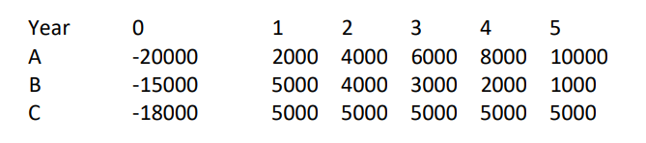
Example
Following cash flows are promised by a friend who is working in an investment bank. There are three plans (A, B, and C). SIB bank is offering an interest rate of 10% on savings deposit. Second column shows the deposits made. Calculate the present value and suggest which option is better.

Slide 35
Example
Calculate the sum of investment after 5 years if (Investments are made today):
Rs. 10,000 invested at 20% interest rate compounding annually.
Rs. 10,000 invested at 20% interest rate compounding quarterly.

Slide 36
Example
Calculate the effective interest rate (Annual) under following situation:
Stated interest rate 12%, compounding quarterly (4 times a year)
Stated interest rate 12%, compounding monthly. (12 times a year)
Stated interest rate 12%, compounding daily. (360 days a year)

Slide 37
Example
You have borrowed a 3-year loan of Rs. 10,000 at 9% from your employer to buy a motorcycle. If your employer requires 3-equal end-of-the year repayment, then the Instalment amount would be?

Slide 38
Example
Suppose you are exactly 30 years old. You believe that you will be able to save certain amount for the next 20 years until you are of age 50. For 10 years following that and till the retirement age of 60, you will have a spike in your expenses and you would not be able to save anything. If you guarantee yourself Rs. 100,000 per year starting from your 61st birthday for next 20 years. – How much should you save every year starting at the end of this year. (assume that your investments are expected to yield 8%).

Slide 39
Present value of a perpetuity
A perpetuity is an annuity of infinite duration.
Flat Perpetuity
Growing Perpetuity

Slide 40
Example
Assuming that Donald holds a perpetual bond that generates an annual payment of $500 each year. He believes that the borrower is creditworthy and that an 8% interest rate will be suitable for this bond. Compute the PV for this perpetuity.
Jacob, a businessman, invested in a company that will pay him a dividend of $8,000 per share annually. He expects a 6% growth rate in the annual payments. Given the possible risks, Jacob expects a valuation of a 16% discount rate. Calculate the value of a share

Slide 41
Effective Annual Rate and Annual Percentage Rate
The effective annual rate (EAR) reflects the total amount of interest that will be earned at the end of one year. The EAR is also referred to as the effective annual yield (EAY) or the annual percentage yield (APY).
We have seen above that ₹ 1,000 grows to ₹ 1,123.6 at the end of a year if the stated rate of interest is 12 percent and compounding is done semiannually. This means that ₹ 1,000 grows at the rate of 12.36 percent per annum. The figure of 12.36 percent is called the effective annual rate

Slide 42
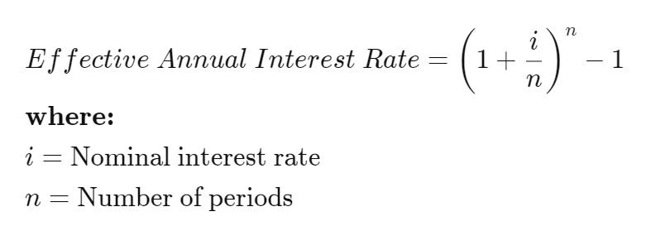

Slide 43
Example
Calculate the effective interest rate (Annual) under following situation:
Stated interest rate 12%, compounding quarterly (4 times a year)
Stated interest rate 12%, compounding monthly. (12 times a year)
Stated interest rate 12%, compounding daily. (360 days a year)

